Slide 1
How to Create a Sound Cybersecurity Breach Strategy
2023 Webinar
Lilian Morvay
CEO, IBDC-RIAC
Insurance Consultant/Insurance Broker
Paul Horn
CEO, H2Cyber
Cybersecurity Expert
Patrick Cox
Expert Witness & Consultant, Bates Group
Hilary Lewis
CEO, La Meer Inc.

Slide 2
What can small firms do to protect themselves?
2023 Webinar

Slide 3
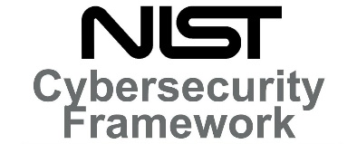
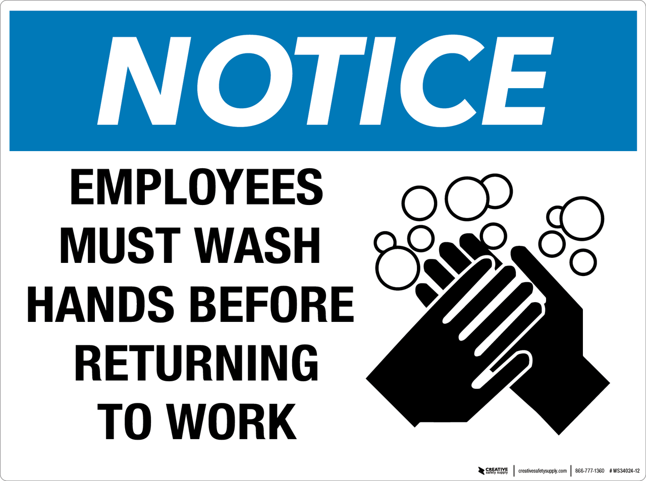
Intended to be the starting point for all organizations
Perform a Risk Assessment commensurate to your business!
Elementary
Middle
High
College
Basic Arithmetic
Geometry
Algebra
Calculus
Natural progression as companies grow
NOT FEASIBLE FOR SMALL BUSINESS AND STARTUPS
Member Firms
Home Office
2023 Webinar

Slide 4
What type personnel should I be looking for to help me?
2023 Webinar

Slide 5
Regulation: NYDFS - Section 500.04
Chief Information Security Officer
Each Covered Entity shall designate a qualified individual responsible for overseeing and implementing the Covered Entity’s cybersecurity program and enforcing its cybersecurity policy.
The CISO may be employed by the Covered Entity, one of its Affiliates or a Third-Party Service Provider.
2023 Webinar

Slide 6
Defined
What constitutes a qualified individual?
Someone that is continuously trained to managed and address evolving cybersecurity treats and respond accordingly with appropriate countermeasures.
Well versed in cyber risk management and maintains a solid understanding of core cybersecurity functions (Identify, Protect, Detect, Respond, and Recover).
What does Qualified or Expertise mean?
Being officially recognized as being trained to perform a particular job; certified.
2023 Webinar

Slide 7
Qualifications
Information Assurance Workforce Qualifications
A widely used methodology for determining qualification for Cybersecurity roles
One of the below certifications is required to hold a CISO level role
Chief Information Security Manager (CISM),
GIAC Security Leadership Certificate (GSLC),
Information System Security Management Professional (CISSP-ISSMP), or
Requires two certifications, the Certified Information Systems Security Professional (CISSP) then the ISSMP
Certified Chief Information Security Officer (CCISO)
Reference DoD 8570 for a list of certifications for your technical staff
2023 Webinar

Slide 8
What can firms do to be ready?
2023 Webinar

Slide 9
Breach Incident Readiness
Insurance
Possible vendor requirements or recommendations
Technology Provider
Day-to-day
Data back up
Security and recovery
Breach
Ransomware
DDOS attacks
Legal
Data breach is specialized
Initial Regulatory Notification
Plan and Contacts
Digital and written copies
Breaches can also happen through one of your vendors
May still need all of the same vendors
2023 Webinar

Slide 10
During A Response
Internal Coordination
Cadence for meetings
Vendors and specialists may need time to do their work between meetings
Accessibility of data backups
Expect assumptions to change
Incidents vary
Breaches, ransomware, DDOS attacks and vendor problems differ
Solution oriented
Communication
Expect assumptions to change
Credibility, consistency and tone
Internal for personnel working on the response
Internal for personnel facing clients and the public
Valuable feedback, but do not let the tail wag the dog
Direct to clients
Notice letters – expedited mailing (possible vendor)
Talking points
Follow-up discussions with some clients
Updates with regulators
2023 Webinar

Slide 11
Follow Up Tasks and Improvements
Regulatory Follow Up
Information Security Investment or Reconfiguration
Policies and Procedures
Vendor Selection and Review
Training
2023 Webinar

Slide 12
Why the need for an integrated approach and a continuous monitoring process?
2023 Webinar

Slide 13
The components that need to be integrated
IT GRC (Governance, Risk and Compliance), Vendor Risk Management
Best Practice frameworks like NIST, CMMC,SoC2, PCI DSS
Policies, Procedures, Controls Definitions, Training and Attestation
Controls Definition Continuous Monitoring, Issue Management
Incident Management
Vendor Due Diligence and Periodic Vendor Monitoring
Data Inventory and Protection, Disposal of Data, Subject Access Rights
Risk Assessment, Business Continuity, Data Protection Mitigation Management
CISOs and Boards need to access real time dashboard information on
Cybersecurity Policies, controls, monitoring processes and issues
Up-to-date Inventory of data and protections in place
View of Risks and mitigation in place
Data Privacy violation issues
Incidents, incident patterns and mitigation
Vendor and supply chain Risk issues
Training Status of Staff Integrated approach ensures early visibility to risks and mitigation to prevent damage and reduce costs
Real time Dashboards for CISOs and line managers for early visibility to risks
2023 Webinar

Slide 14
Managing a Cyber Incident
Incident Response Plan – Well defined roles and responsibilities, Incident Response Drill
Having a ready to go inventory of information – internal and with vendors for e-discovery and establishment of materiality
Ensure the Incident Management is done in an organized way without creating new losses
Ransomware attacks - Provide for manual processes, and ensure backup and business continuity processes are working well
Take Legal help to draft Incident Response for the World
Enlist and train employees for their roles and ensure incidents are not leaked out leading to regulator finding out from social media or clients getting anxious
Regulatory reporting obligations and regulatory response
Ensure proper completion of incident response activities
Learn lessons from weaknesses and failures for future prevention
Establishing best practices from frameworks, continuous controls monitoring, and visible real time dashboards can help catch failures early, and prevent damage
2023 Webinar

Slide 15
What risks must Senior Management address?
2023 Webinar

Slide 16
IT and Compliance Risks
RAPIDLY INCREASING INFLUX OF REGULATIONS IN CYBER INCIDENT REPORTING AND DATA PRIVACY
HEIGHTENED SCRUTINY FROM CYBER INCIDENTS AND RANSOMWARE ATTACKS BY REGULATORS
48/72 HOUR INCIDENT REPORTING BASED ON MATERIALITY
MONITORING COMPLIANCE IN THE SUPPLY CHAIN
TACKLING NEW AND RAPIDLY EVOLVING CYBER THREATS
KEEPING STAFF AND RELATED PERSONNEL UP-TO-DATE WITH THREAT AND COMPLIANCE TRAINING
BE PREPARED FOR DUE DILIGENCE FROM CYBER INSURERS AND HIGHER COST OF CYBER INSURANCE
RISK OF INCIDENTS NOT JUST IN MONETARY TERMS BUT ALSO REPUTATION RISK AND SOMETIMES CLASS ACTION LAWSUITS
2023 Webinar

Slide 17
What are some of the Regulations firms need to be aware of?
2023 Webinar

Slide 18
Cybersecurity
FTC Standards for Safeguarding Customer Information (16 CFR Part 314)
SEC Cybersecurity Risk Management, Strategy, Governance, and Incident Disclosure for Public Companies
Department of Labor Cybersecurity Guidance for Plan Sponsors, Plan Fiduciaries, Record Keepers, and Plan Participants
NYDFS Cybersecurity Requirements for Financial Services Companies (23 NYCRR 500)
SEC Cybersecurity Risk Management Rule for Broker-Dealers
SEC Cybersecurity Risk Management for Investment Advisers
2023 Webinar

Slide 19
Data Privacy: California Breach reporting
California law requires a business or state agency to notify any California resident whose unencrypted personal information, as defined, was acquired, or reasonably believed to have been acquired, by an unauthorized person. (California Civil Code s. 1798.29(a) [agency] and California Civ. Code s. 1798.82(a) [person or business].)
Any person or business that is required to issue a security breach notification to more than 500 California residents as a result of a single breach of the security system shall electronically submit a single sample copy of that security breach notification, excluding any personally identifiable information, to the Attorney General. (California Civil Code s. 1798.29(e) [agency] and California Civ. Code s. 1798.82(f) [person or business].)
2023 Webinar

Slide 20
Data Privacy regulations as of Oct 2023
California Consumer Privacy Act (CCPA) 2018 Effective Date 01/01/2023
Colorado Privacy Act (CPA) 2021 Effective date 07/01/2023
Connecticut Data Privacy Act of 2022 (CTDPA) Effective date 07/01/2023
Delaware Personal Data Privacy Act (DPDPA) Effective Date 01/01/2025
Florida Digital Bill of Rights (FDBR) Effective Date 12/31/2023
Indiana Consumer Data Protection Act of 2023 (Indiana CDPA) Effective Date 01/01/2026
Iowa Consumer Data Protection Act of 2023 (Iowa CDPA) Effective Date 01/01/2025
Montana Consumer Data Privacy Act of 2023 (MCDPA) Effective Date 01/01/2024
Oregon Consumer Privacy Act (OCPA) Effective Date 07/01/2024
Tennessee Information Protection Act of 2023 (TIPA) Effective Date 07/01/2025
Texas Data Privacy and Security Act (TDPSA) Effective Date 03/01/2024
Utah Consumer Privacy Act of 2022 (UCDPA) Effective Date 12/31/2023
Virginia Consumer Data Protection Act of 2021 (VCDPA) Effective Date 01/01/2023
2023 Webinar

Slide 21
Do I have to comply with NYDFS?
2023 Webinar

Slide 22
NYDFS Exemptions and Cybersecurity Program
Exemptions (Alleviates you from some not ALL requirements)
Fewer than 10 employees or contractors in New York or responsible for business of the entity, or
Less than $5M in gross annual revenue in each of last 3 fiscal years in New York, or
Less than $10M in year-end total assets calculated in accordance with GAAP
Program
Risk assessment
Internal and external threats to nonpublic personal information
Use defensive infrastructure and policies and procedures
Detect cybersecurity events
Respond to an mitigate negative effects of cybersecurity events
Recover from cybersecurity events and restore normal operations
Fulfill regulatory reporting obligations
2023 Webinar

Slide 23
NYDFS Subsections (and Certification Prep)
Cybersecurity Policy
Includes specific requirements
Chief Information Security Officer
Penetration Testing and Vulnerability Assessments
Audit Trail
Access Privileges
Application Security
Risk Assessment
Cybersecurity Personnel and Intelligence
Third Party Service Provider Security Policy
Multi-Factor Authentication
Limitations on Data Retention
Training and Monitoring
Encryption of Nonpublic Information
Incident Response Plan
Notices to Superintendent (of NYDFS) and Annual Compliance Certification
2023 Webinar

Slide 24
Are all cybersecurity insurance policies equal?
2023 Webinar

Slide 25
Important Cybersecurity Insurance Considerations
If the Broker Dealer/RIA firm that you are contracted or affiliated with has a cybersecurity policy, confirm whether that policy will provide you with coverage in the event you suffer a cybersecurity breach. Not all master Broker Dealer cyber policies provide coverage to its independent registered reps and/or advisors.
Does the cyber policy "pay on behalf of" or reimburse the insured in the event of a loss?
Does the cyber policy provide coverage for fraudulent fund transfer losses? If it does, is there a lower limit of liability? Are there specific conditions that must be met in order for coverage to be triggered?
Will the cyber insurance carrier provide your firm with ongoing monitoring of your network to help prevent a cyber breach?
Will your cyber insurance carrier work with you to address cyber vulnerabilities after a breach?
Does your cyber carrier offer pre-claim assistance? Is their hotline supported by third-party vendors, or is the carrier providing this service directly?
2023 Webinar

Slide 26
What are some takeaways from our discussion?
2023 Webinar

Slide 27
Three Key Takeaways
Be proactive and leverage personnel certified within the Cybersecurity field. Information Technology and Cybersecurity are different skillsets.
Actively manage your Cybersecurity risks and practice your Incident Response efforts regularly. Have a Cyber Breach Lawyer.
The right cybersecurity insurance policy will provide you with the necessary resources and support even before you sustain a cybersecurity breach.
2023 Webinar

Slide 28
Contact Info and Q&A
2023 Webinar
Lilian Morvay
Lilian@IBDCconsulting.com
203-249-1712
Paul Horn
Paul.Horn@h2cyber.com
469-730-4700
Patrick Cox
pcox@Batesgroup.com
503-670-7772
Hilary Lewis
laxmi@lameerinc.com
408-740-7205

